Slide 1

Setting up your ML application
Bias/Variance
deeplearning.ai

Slide 2
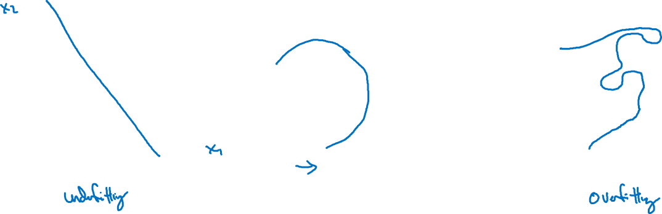
Bias and Variance
high bias
“just right”
high variance

Slide 3
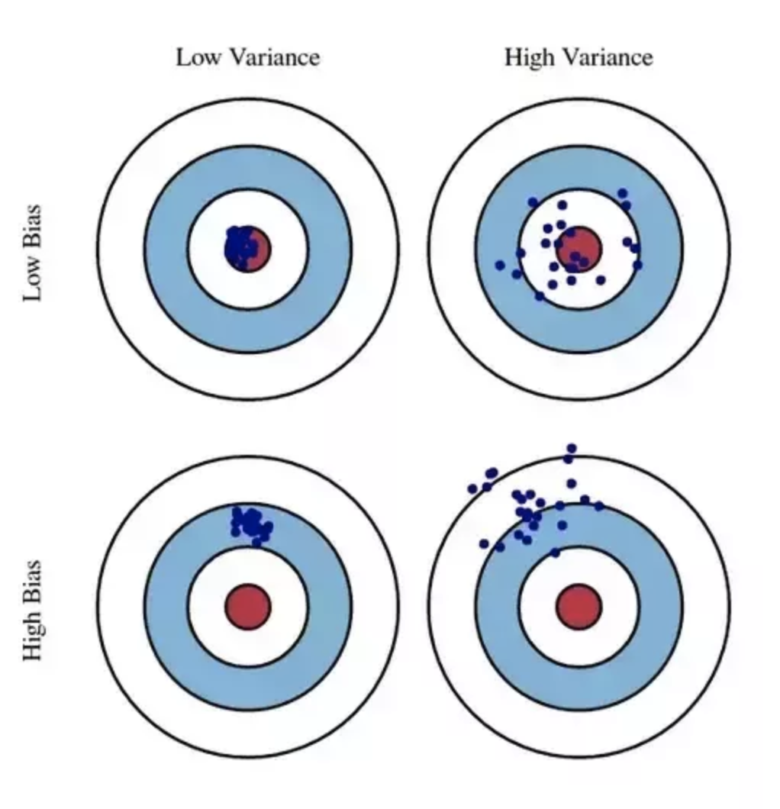
High bias is equivalent to aiming in the wrong place. High variance is equivalent to having an unsteady aim.
https://www.quora.com/What-is-high-bias-and-high-variance-in-machine-learning-terminology-in-simplest-terms

Slide 4

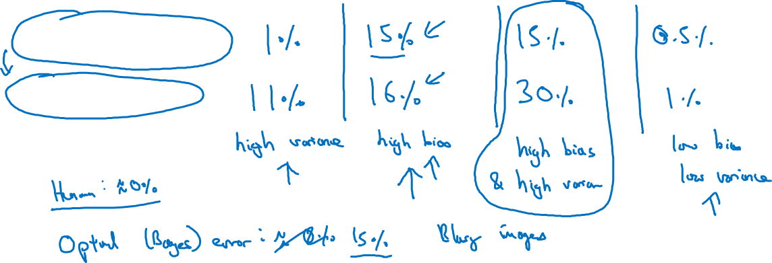
Bias and Variance
Cat classification
Train set error:
Dev set error:

Slide 5
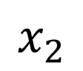
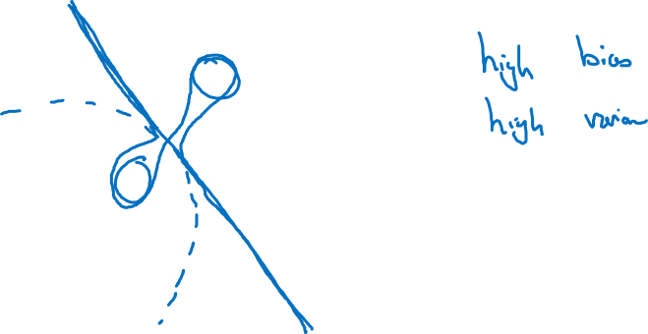
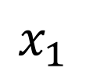
High bias and high variance
$$x_{2}$$
$$x_{1}$$

Slide 6
Setting up your ML application
Basic “recipe”
for machine learning
deeplearning.ai

Slide 7
Basic “recipe” for machine learning

Slide 8
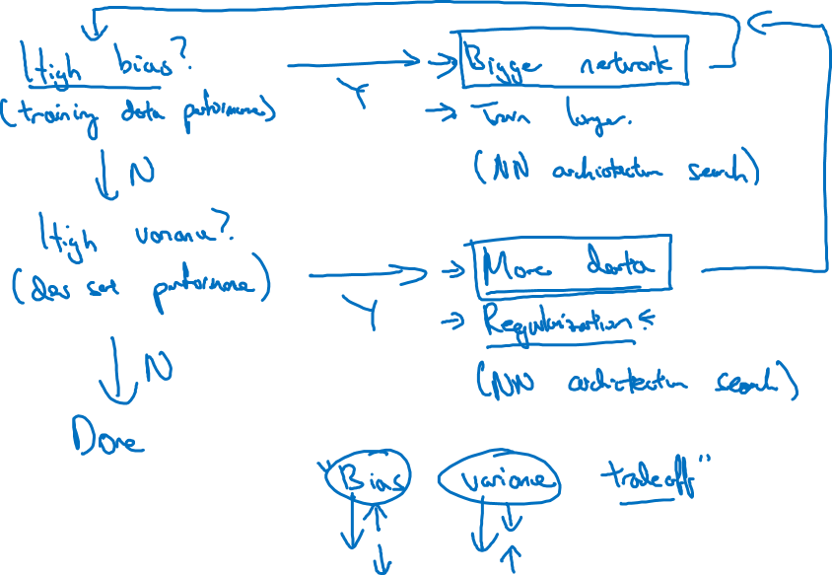
Basic recipe for machine learning

